Slide 1

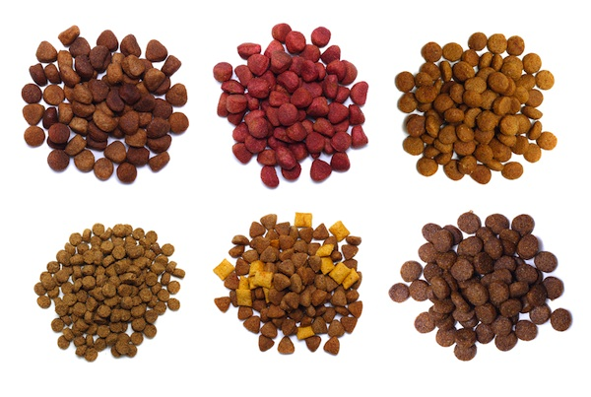
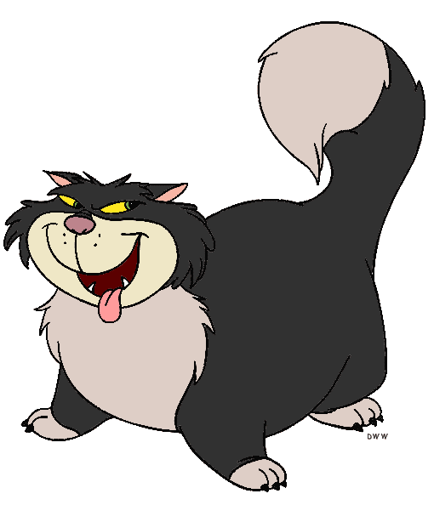

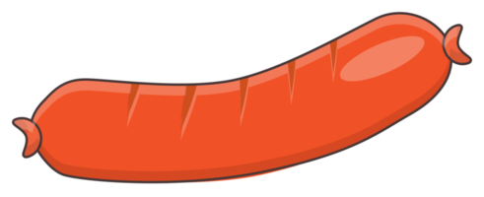
Doggo / Nogo
A Modern Comprehensive Additive Cognitive Control Paradigm

Slide 2
Goal:
Develop an engaging, reliable, comprehensive paradigm for cognitive control
To be used as an neuropsychological index (correlate with other processes / assessment)
To be used to investigate the role of interoceptive mechanisms

Slide 3
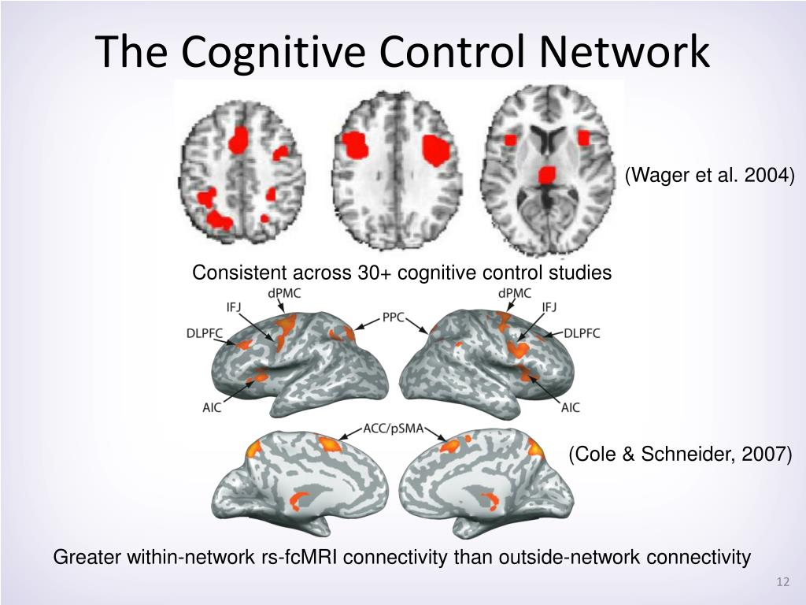
Why?
Cognitive Control
« Cognitive Control » is a critical cognitive function and its impairment a transdiagnostic symptom
It is not a unitary construct but refers to a variety of mechanisms
Processing speed, attention control
Inhibition (motor inhibition, response inhibition, …)
Conflict (conflict monitoring, conflict resolution, …)
Mental set shifting (task rules inhibition and switching…)
Working memory (short term memory, updating, …)
Multiple tasks exist to measure them (Stroop, flanker, Simon, Go/Nogo, Stop-signal, ANT, …)
Problem
Low psychometric-to-behavior predictive power
Low correlation between various tasks
Low reliability of tasks
Large samples with comprehensive batteries difficult
Solution(s)
Better analysis approaches (e.g., mixed models, decision making models – aka « Sequential Sampling Models »)
More engaging tasks (gamification?)
More controlled manipulations (better « control » conditions, etc.)
More systematic and sequential (additive) quantification procedure

Slide 4
Systematic Additive Paradigm
Many neuropsychological tasks are based on the « substractive » paradigm
Contrast of 2 conditions (e.g., incongruent – congruent)
Good but issues with reliability
Cronbach’s merger
Solution: Systematically measure the baseline proficiency
Baseline Proficiency
Target condition
(e.g., « conflict » or « incongruent »)
Target mechanism + Random processes
+ Context?
Control condition
(e.g., « congruent »)
Random processes
+ Context?

Slide 5
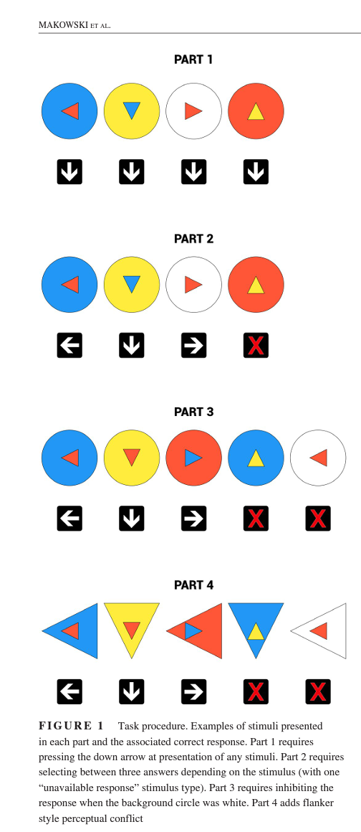
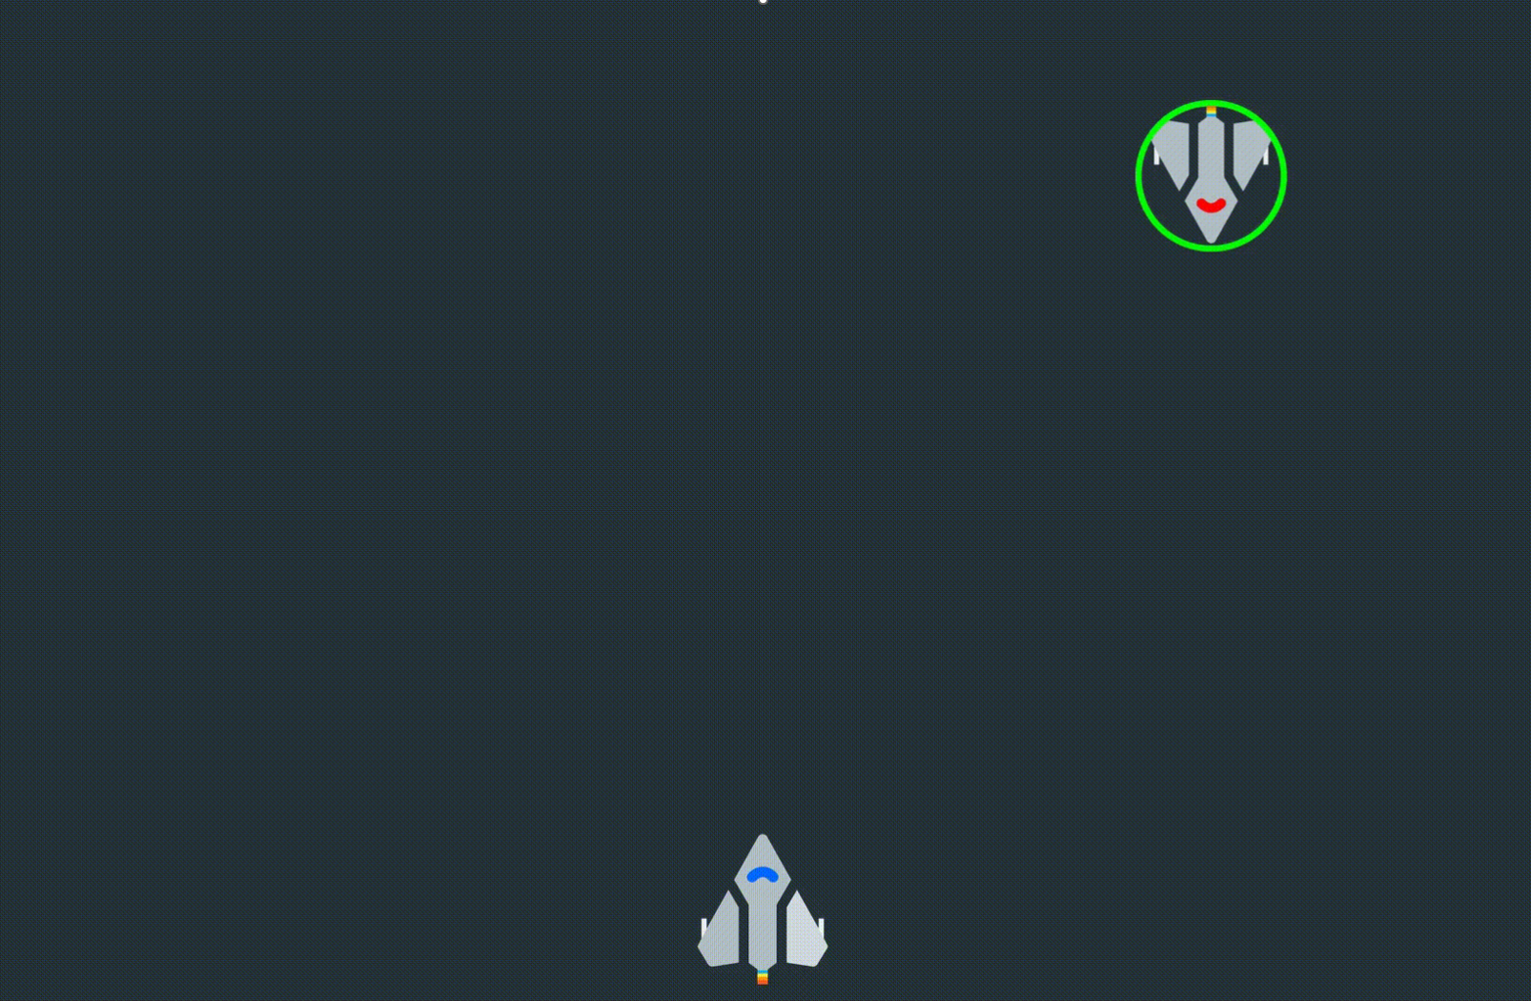


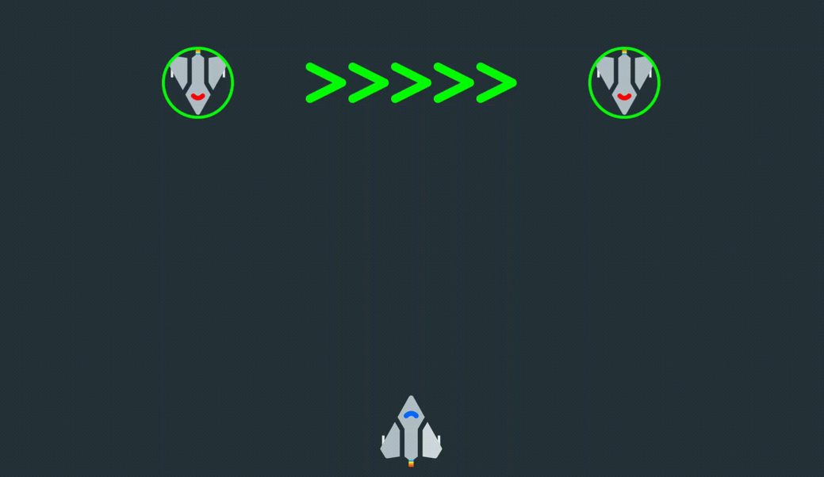
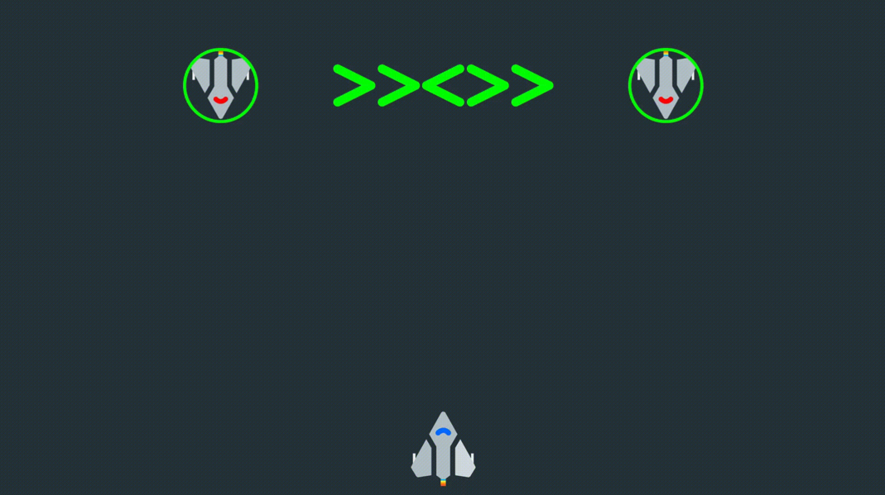
How?
Cognitive Control Task v1 (Cocon)
Sequential and additive decomposition mechanisms
Part 1: Processing Speed
Simple reaction time task
Part 2: Response Selection
Congruent response choice
Part 3: Response Inhibition
Go/No Go Paradigm
Part 4: Conflict Resolution
« Flanker » Paradigm
Issues
Amount of trials
Not engaging
Cognitive Control Task v2 (Star Control)
Narrative Context
Phase 1: Processing Speed
Phase 2: Response Selection
Phase 3: Stop Signal Task
Phase 4: Flanker
Issues
Static
Not online

Slide 6
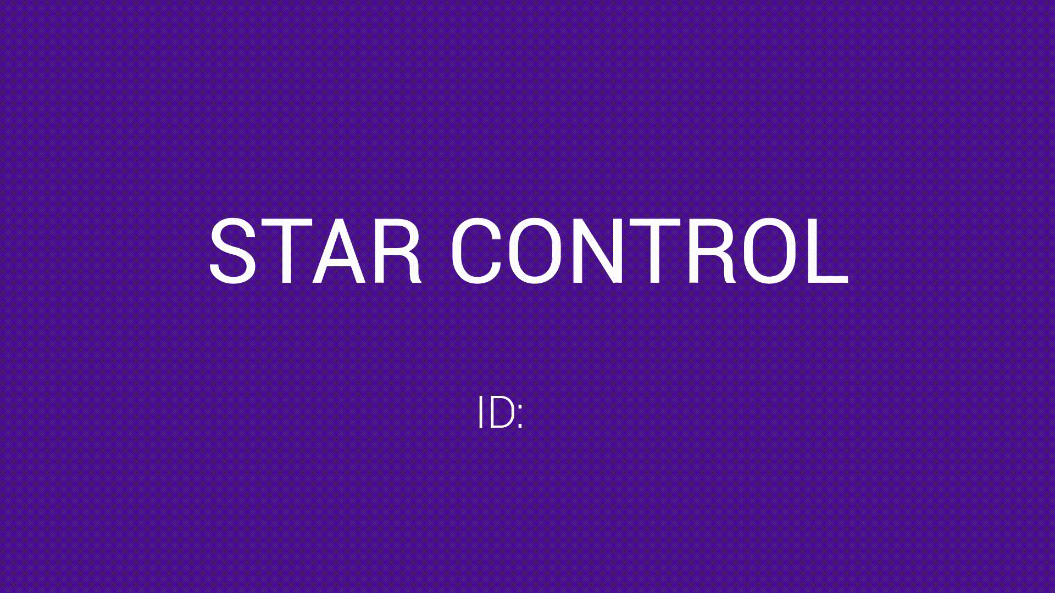

Slide 7
Doggo / Nogo
« Real » user Game (score, levels, scoreboard, …)
Online
Engaging engough for self-engagement (big data?)
Outcomes
Better understand the unicity/diversity of CC tasks
Suited for wide range of ages & conditions
A unified framework for evaluating various aspects of CC
Story idea
We rescue a dog (named « Doggo ») and need to feed him.
But the cat (« Nogo ») is jealous?
Intro video with static images
Challenges
Art (AI? Collab with artists? But placeholders)
Animations
Backend (Data collection, storage, re-playability)

Slide 8
Menus
Start screen
Start a New Game
E-mail address
Age
Gender
Already played?
E-mail address
Continue
Start a New Game
Read Terms & Conditions
Need for a mention « by playing, I accept the terms & conditions »
About
Description, contact, etc.

Slide 9
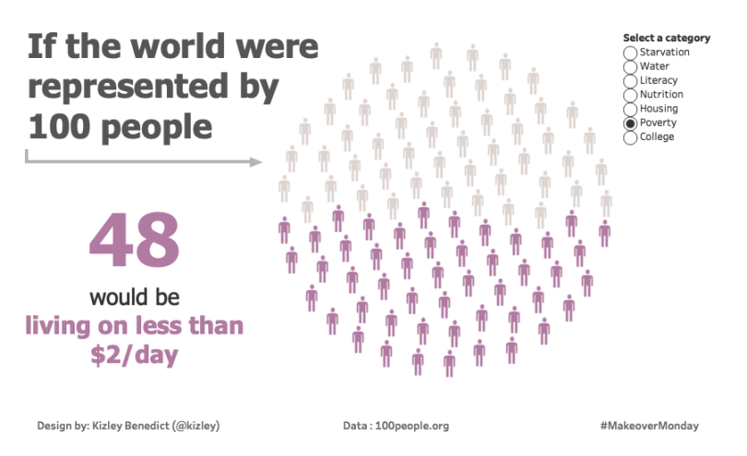
Score and End Screen
Marketing
Test your brain
Train your brain*
Fluid intelligence is a key symptom of many psychiatric disorders… preserve it
Cognitive training / rehabilitation is a validated procedure used in neuropsychology
General final score (« leaderboard »)
Score number + chart
Relative to the population: auto-updated from the database?
+ score by levels?
If score too low, do not display comparison chart, but instead tips on how to do better?
Replay button
Can jump to specific level
Provides a code that can be copied (to be used in other studies, e.g., prolific & lab-studies)

Slide 10
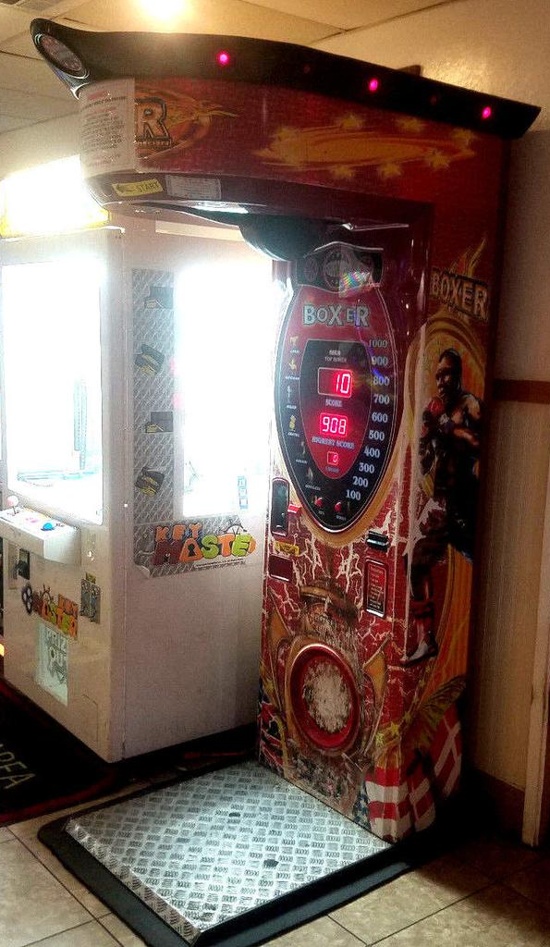
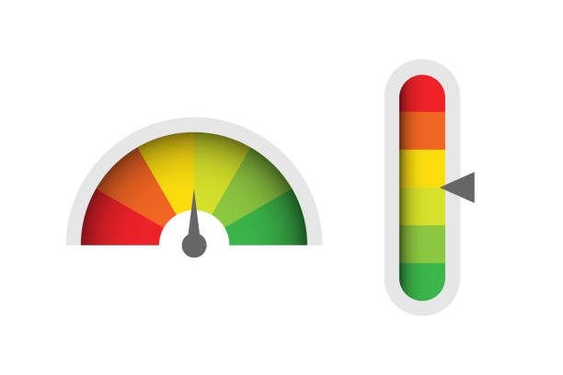
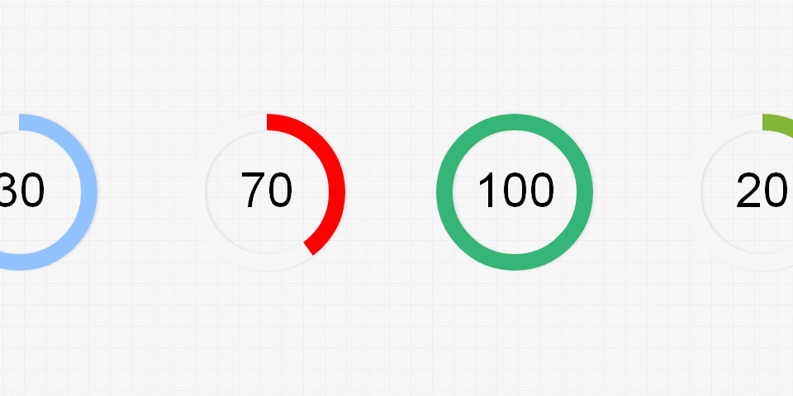
Level 1: Simple Reaction Time
457
3 blocks
The dog sprite « evolves » between each: Rewarding aspect
From malnourished skinny dog to majestic shiny one
Animation
« Warf » when button is pressed fast enough (e.g., < average) with dog smiling (Positive feedback)
Groan if slow answer with dog being like « :S »
Stimuli gets « bad » over time (speed of animation depends on the distribution of participant’s RTs, e.g., 95% ETI, or 2*average)
Score gets updated with a color gradient that depends on the speed (same underlying variable controls the color of the score update and the aspect of the stimulus)
End scree
Score (IES) increases alongside a bar that gets filled up following the percentile score
457
457

Slide 11
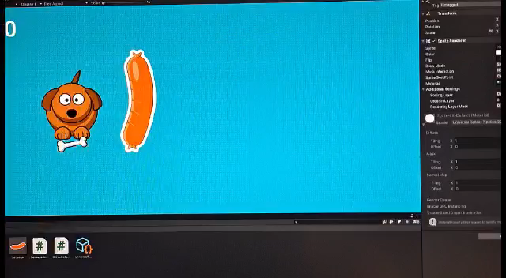

Slide 12



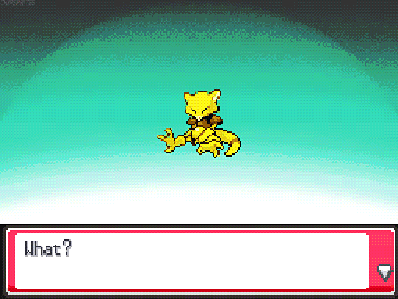
Score computation
Score starts at 0
If « Positive » trial (RT <= Threshold), score increases
+ log(1 + |Threshold – RT|)
If « Negative » trial (RT <= Threshold), score decreases
- log(1 + | Threshold – RT|)
Score udpate is multiplied by RT so slow RT are penalized (regardless of the difference)
Have a maximum treshold (~600 ms?) to avoid cheating
Character evolution
Depending on score
Shiny dog 1: score [100, 1000]
Default dog: score [-100, 100]
Malnourished dog: score [-1000, -100]
When new range is reached, make « evolution » screen

Slide 13
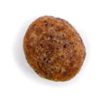
Level 2: Motor Response Choice
457
Level 2a: Response Choice – Association creation
Same as previously but different sprites / animations / sounds
Level 2b: Response Choice – Associative
Level 2c: Response Choice conflit : Simon task
457
Conflict
457
457
457
457

Slide 14
Level X: Response Inhibition (Stop signal)
457

Slide 15
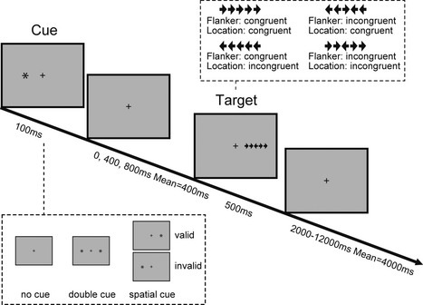

Level X: Attentional Control (ANT)
Conditions
No cue
Uninformative cue
Valid cue
Incongruent cue
457
457
457

Slide 16
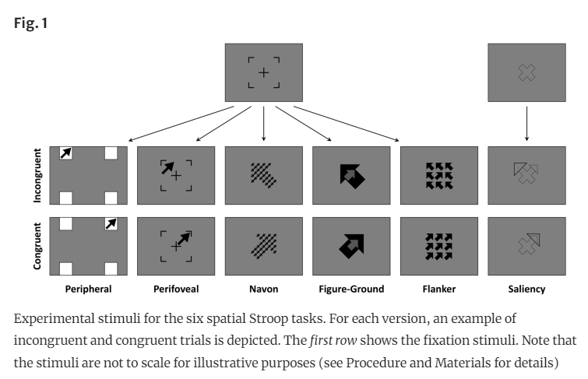
Level X: Perceptual Control (Flanker)
Conditions
Varying degrees of conflict
Double shot condition (Kucin, …, and Heathcote, 2023)
Diagonal? (double response = up + right)
« Spatial stroop » (Viviani et al., 2023)
Perifoveal is the best

Slide 17
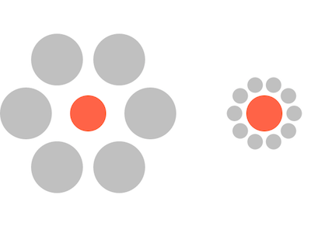
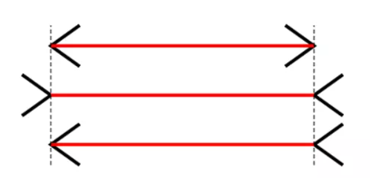
Level X: Perceptual Control (Illusion)

Slide 18
Storyboard
Intro: Rescuing sad Doggo from a shelter
Level 1 (Simple RT): Saving private Doggo
Level 2 (Motor decision): Nogo tries to steal food? Mice?
Level X (Stop signal): Doggo starts a diet
…

Slide 19
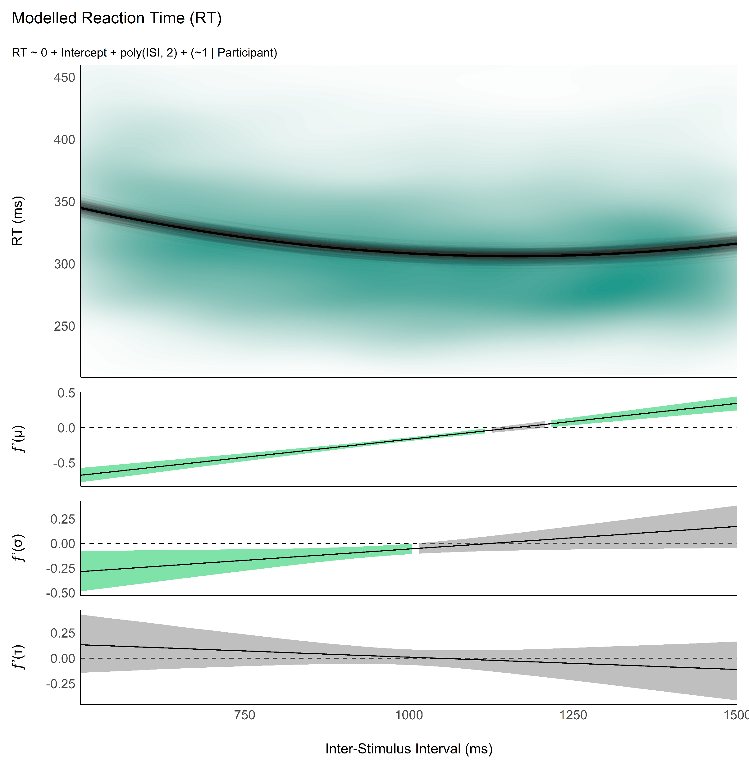
Study 1a: Development of the Optimal Simple RT Task
Reliability - How many trials?
Run experiment with high number of trials
Analyze convergence of estimates
Analysis
Optimal model: LBA? Wald? LNR? DDM?
Ancillary project
Optimal priors for individual SSMs from group-level
Effect of ISI
Measure minimum of U effect in each participant
Define the best ISI range (95%) to capture that minimum

Slide 20
Study 1b: Validation of the Optimal Simple RT Task
Gamification
Compare gamified vs. Stripped RT task
Questions about duration perception « how long did you play for? »
« How much would you be annoyed if you had to do the task again? »

Slide 21
Studies
Study 1: Statistical power - How many trials in each phase
Run experiment with high number of trials
Analyze convergence of estimates
Study 2: Reliability
Test retest
Improved reliability via prediction of estimates based on other scores (e.g., simple RT)
Study 3: Validity
Clinical groups (ADHD)? Aging?
Personality
IQ / Fluid intelligence
Emotion regulation
Neurophysiological Determinants
Cardiac phase
HRV correlates
EEG

